Slide 2
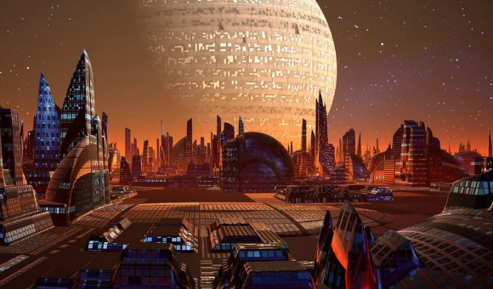
Life in the Future

Slide 3
Life in the Past and at Present in different aspects
1. Transport
horse
carriage
boat
car
plane
train
subway

Slide 4
Life in the Past and at Present
2. communication
pigeon
telegraph
phone
e-mail
software

Slide 5
Life in the Past and at Present
3. houses
wooden house
stone house
flat
mansion
skyscraper

Slide 6
Life in the Past and at Present
4. shopping
market
shopping mall
online shopping

Slide 7
Life in the Past and at Present
5. payment
gold
coin
cash
credit card
online payment

Slide 8
Reading: First Impression
paragraph 1 & 2:
Why did Li Qiang take the future tour?
What is a “time lag”?
Why was he given some tablets?
How did he feel about the journey?
Li Qiang came to take a time travel journey

Slide 9
Reading: First Impression
paragraph 3:
How did Li Qing feel as soon as he was transported to the future?
How did Wang Ping solve the problem?
Why did he get separated from Wang Ping?
Li Qiang’s first impression of life one thousand years in the future

Slide 10
Reading: First Impression
paragraph 4:
What did Wang Ping’s house look like?
What was the wall made of? What was the function of it?
Li Qiang’s stay at Wang Ping’s house

Slide 11
Reading: First Impression
Do you think the writer has an optimistic or a pessimistic view of the future?

Slide 12
Reading: I have seen amazing things
Modern Inventions of the 31st Century
 | Communication | Waste Disposal | Manufacturing
invention
advantages
disadvantages
thoughtpad
waste machine
robots
quick
efficient
environmentally friendly
collect everything
turn the waste into materials
no waste
no pollution
no environmental damage
the thought must be clear
people must live on a space station to monitor the robots

Slide 13
国庆作业
1.阅读teens第4期，完成P7全部作业，其中day1-day4作业相对应的文章请精读，熟悉单词，找出短语，划出难句并翻译。
2.完成双语报第4期练习一套
3.复习unit1，2，3单词，短语和课文
4.语法可以复习非谓语动词，预习倒装

